Slide 1



SMART INDIA HACKATHON 2025
Problem Statement ID – 25102
Problem Statement Title- Ai based droup-out prediction and counselling system
Theme- Smart Automation
PS Category- Software
Team ID-
Team Name - Eleetcoders

Slide 2

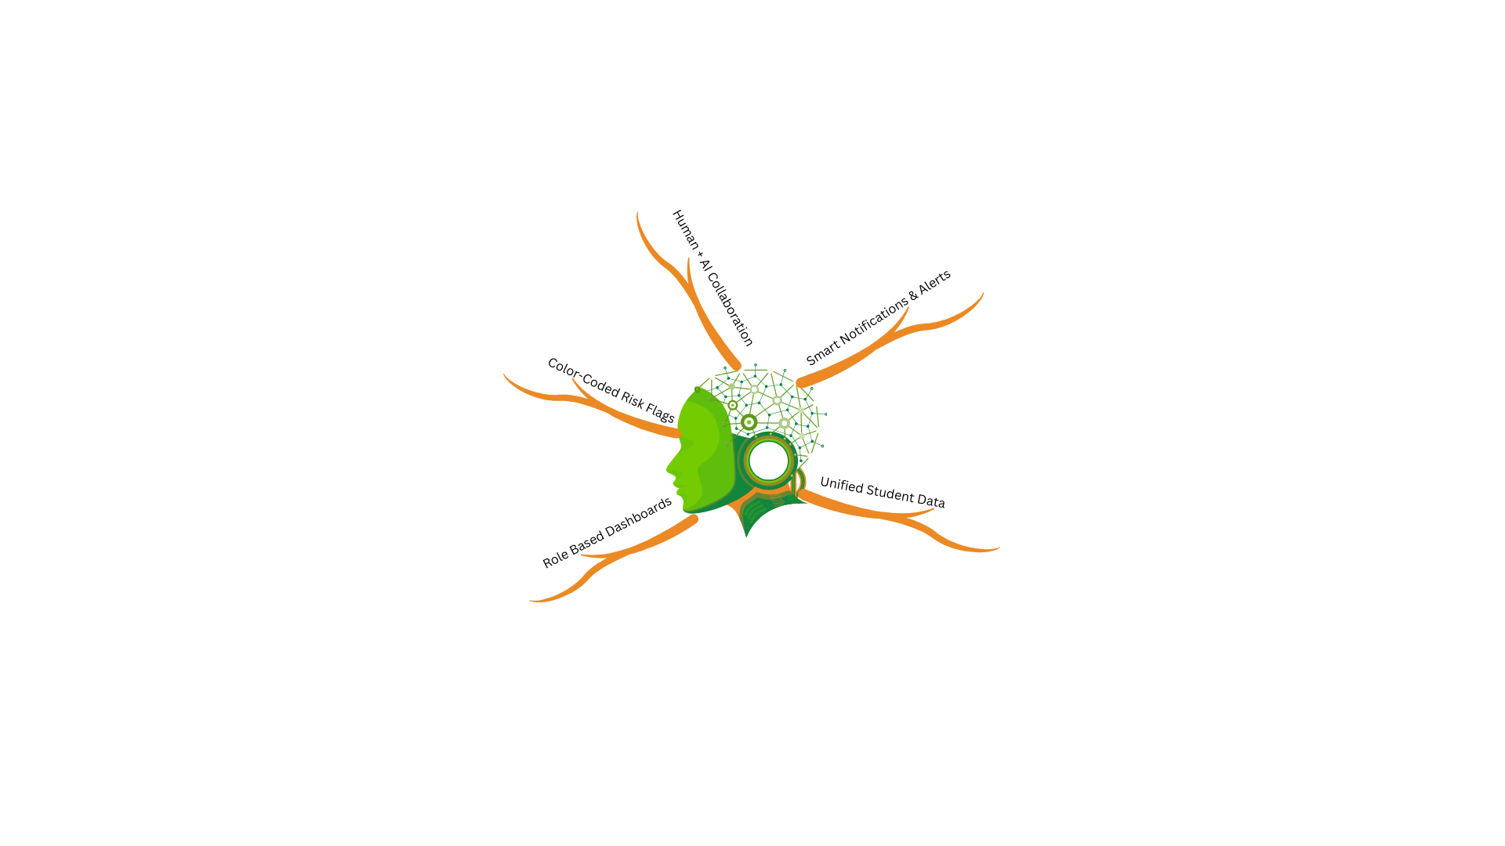
शिक्षाShield
Idea
Approach
Students often go unnoticed until final exams because attendance, scores, and fee data are scattered. शिक्षाShield unifies this data, applies simple rules and ML to flag at-risk students, and sends timely alerts to mentors and guardians for early intervention.
We merge existing student data into one system, analyze it with rules and ML, visualize risks through dashboards, and trigger automated alerts to enable quick, data-driven action.
@SIH Idea submission- Template
2
Notes:
2

Slide 3
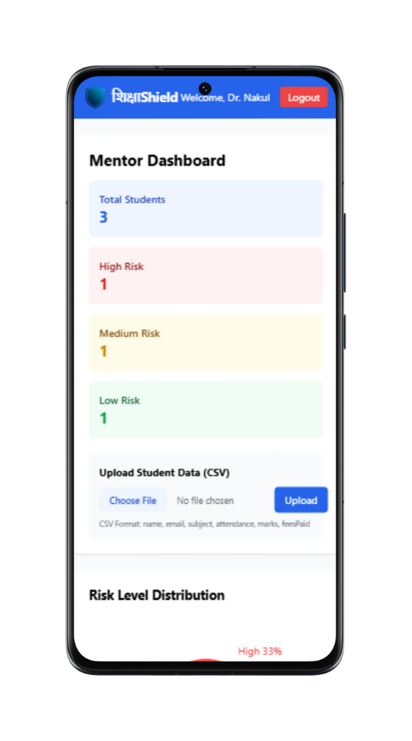
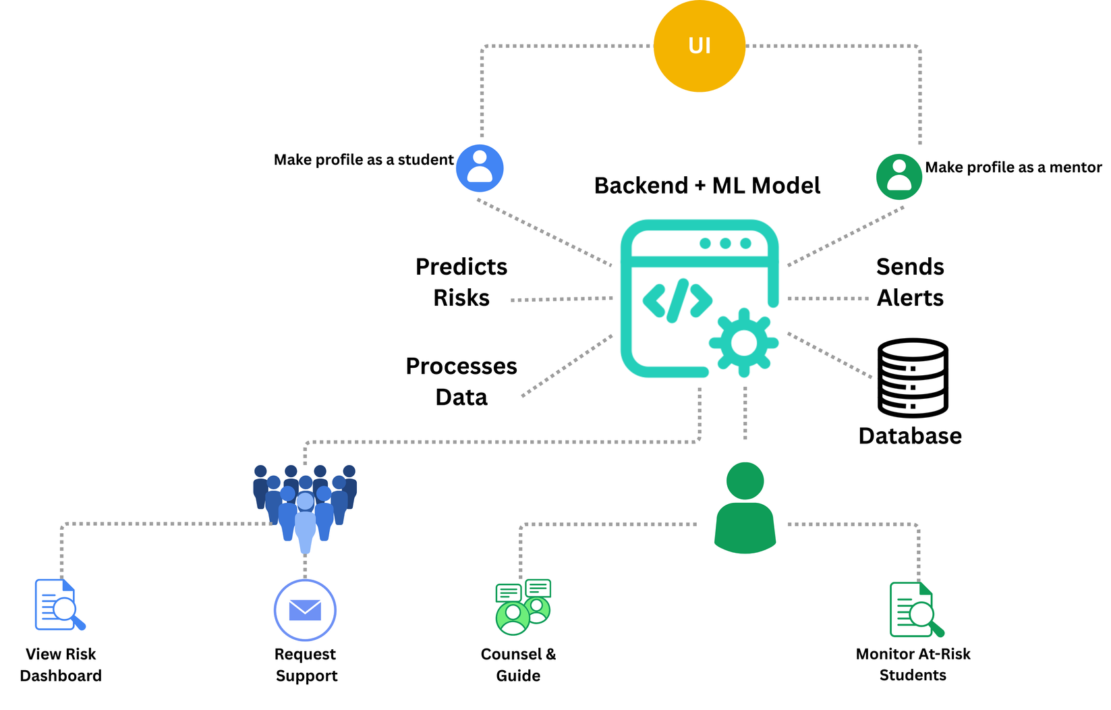

Technical Approach
MongoDB
ExpressJS
Tailwind CSS
React
Flask
NodeJS
@SIH Idea submission- Template
3
Notes:
3

Slide 4
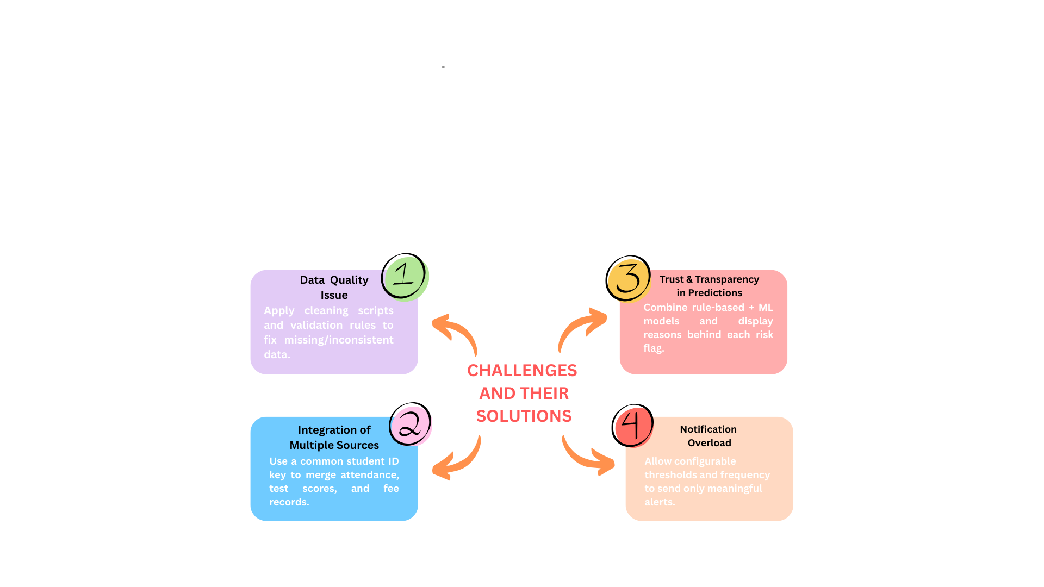
FEASIBILITY AND VIABILITY
शिक्षाShield is feasible and viable because:
Leverages Existing Data → Uses current attendance, marks, and fee spreadsheets, no new infrastructure needed.
Cost-Effective → Built on open-source tools (Node.js, React, Flask, MongoDB) with zero licensing costs.
Lightweight & Scalable → Simple ML models and modular design make it easy to deploy and expand.
User-Friendly → Clear dashboards, color codes, and role-based views require minimal training.
High Impact → Enables early detection and timely intervention, directly reducing dropouts.
@SIH Idea submission- Template
4
Notes:
4

Slide 5



IMPACT AND BENEFITS
Social
Economic
Improved Student Retention
Stronger Mentor–Guardian Collaboration
Empowered Educators
Inclusive Education
Better Career Outcomes
Low-Cost Open-Source Solution
Eliminates Expensive Licensing Fees
Minimal Training Required
Retains Revenue by Reducing Dropouts
Scalable Without Additional Infrastructure
Environmental
Reduced Paper Usage via Digital Dashboards
Sustainable Tech with Lightweight Open-Source Tools
Remote Access Minimizes Travel Impact
Extended Hardware Lifespan, Less E-Waste
Efficient Resource Utilization in Institutions
@SIH Idea submission- Template
5
Notes:
5

Slide 6


RESEARCH AND REFERENCES
Comparision with existing systems
References
Feature | शिक्षाShield | Civitas Learning | Blackboard Predict
Consolidates attendance data
Consolidates assessment/test scores
Consolidates fee/payment data
Early-warning alerts before term-end
Color-coded risk levels
Plain-language explanations for risk
Interpretable / transparent ML
Civitas Learning (2024):
https://www.civitaslearning.com
Blackboard Inc. (2024):
https://www.anthology.com
https://doi.org/10.1007/978-1-4614-3305-7_4
https://doi.org/10.1109/TSMCC.2010.2053532
https://www.tandfonline.com/doi/full/10.1080/14703297.2024.2396092
PLATFORM DEMO VIDEO LINK:
https://drive.google.com/file/d/15tYuQrOJ-5ZrzY8IKZPvoVAjkshNYkXR/view?usp=sharing
@SIH Idea submission- Template
6
Notes:
6

